Slide 1
NES Project – Task 3 Player Movement
Daniel José Febles Bustillo

Slide 2
Video Objectives
Summarize the peculiarities regarding the NES controller
Showcase the new constants and variables that will be used
Describe the subroutine to extract the player inputs
Update the anim_player code to take advantage of the controller inputs
Show the results of the process

Slide 3
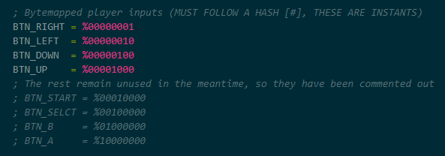
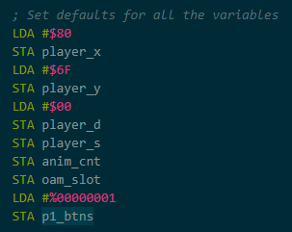
NES Controllers
The NES controller, counterintuitively, uses a parallel-to-serial latch to send the NES clock signals relevant to the controller inputs
This means cycling through a byte bit by bit to get all the inputs
A new address is required to receive these latched inputs
We will also make new constants for each button input and a zero-page variable to store player inputs
Update the initial zero-page values to be more precise
P1_btns starts with a single bit to distinguish controller inputs

Slide 4
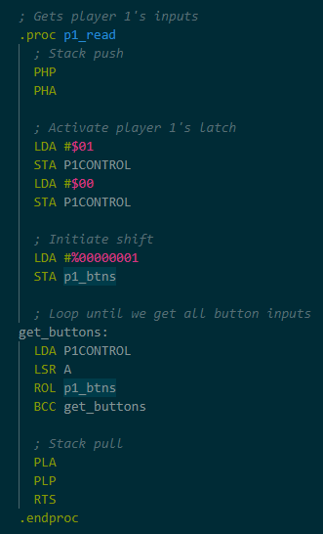
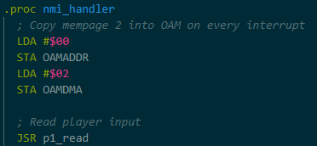
New Controller Subroutine
Esta subrutina hace los bit-shifts necesarios para poder guardar los inputs
Primero se inicia el latch por P1CONTROL para poder recibir las señales
Después se guarda un bit de frente en p1_btns como marca de referencia
Por cada iteración del loop, se guarda un input al flanco del reloj, que se mueve al carry por un shift a la derecha del acumulador y después se guarda en la variable de p1_btns con un shift a la izquierda
El loop continua hasta que el bit de frente llega al carry, significando que ya todos los inputs del controlador han sido registrados
Se llamará esta subrutina cada vez que se interrupta el NMI

Slide 5
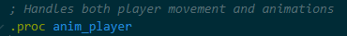
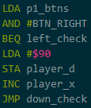
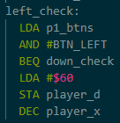
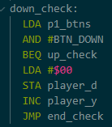
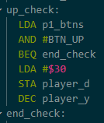
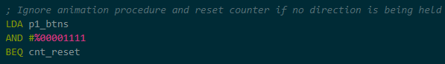
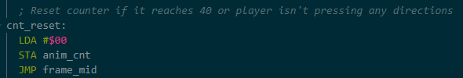
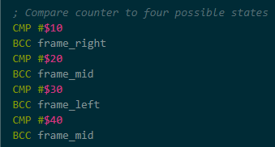
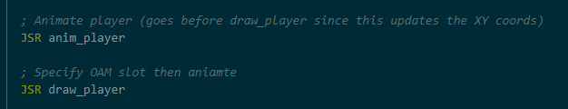
Updating anim_player
Add input detection to anim_player to take advantage of the new subroutine
Check every directional input to change both the sprite’s coordinate and direction
Ignore the animation if no directional button is held, adding a jump label to the counter reset
Change animation frames order to initialize the animation with movement
Update NMI interrupt code, making sure anim_player goes first so that draw_player uses the most updated player coordinates

Slide 6
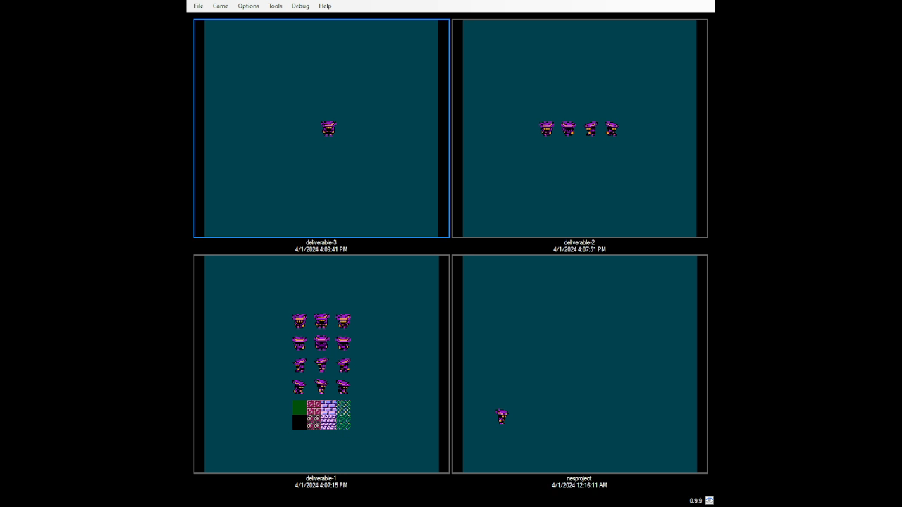
Final Result

Slide 7
Thank you for your attention

